Slide 1
Modeling Titanic
Data

Slide 2
Overview
Model Training
Model Evaluation

Slide 3
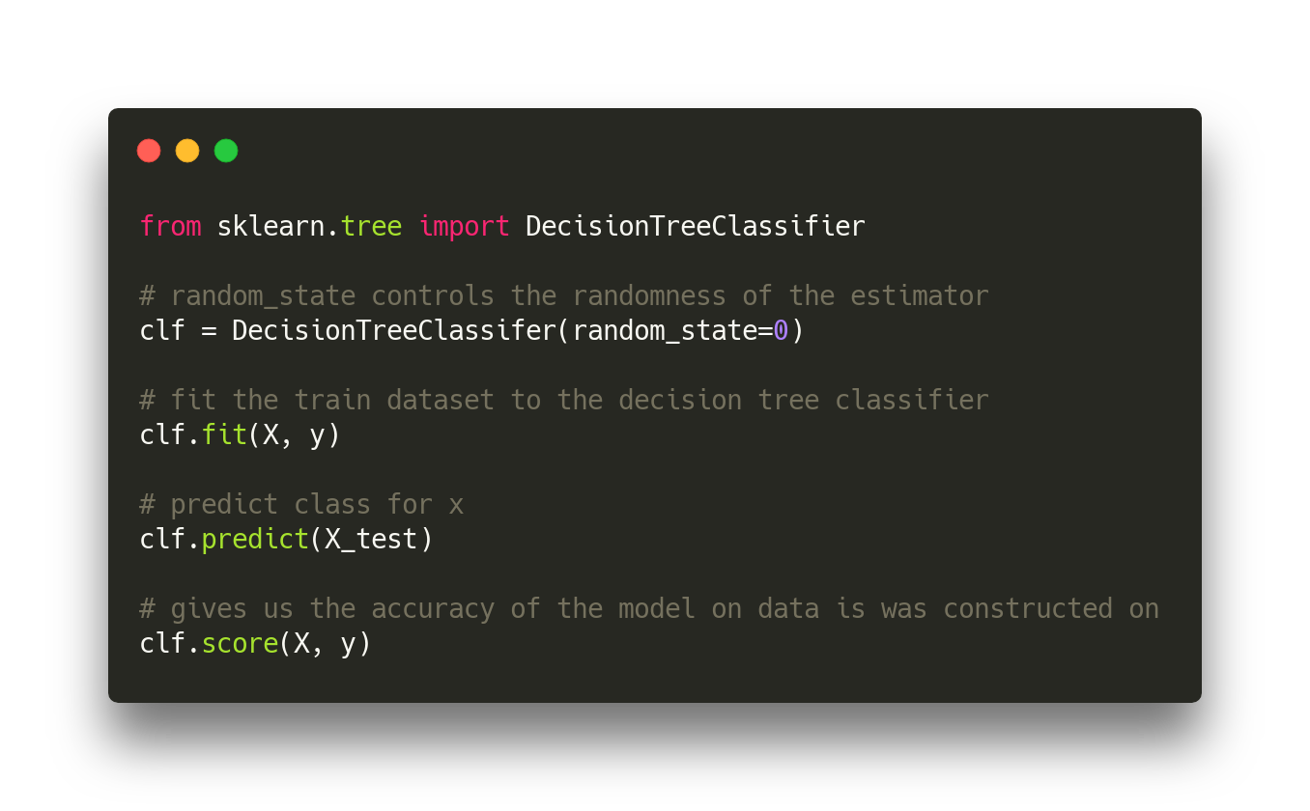
Decision tree

Slide 4
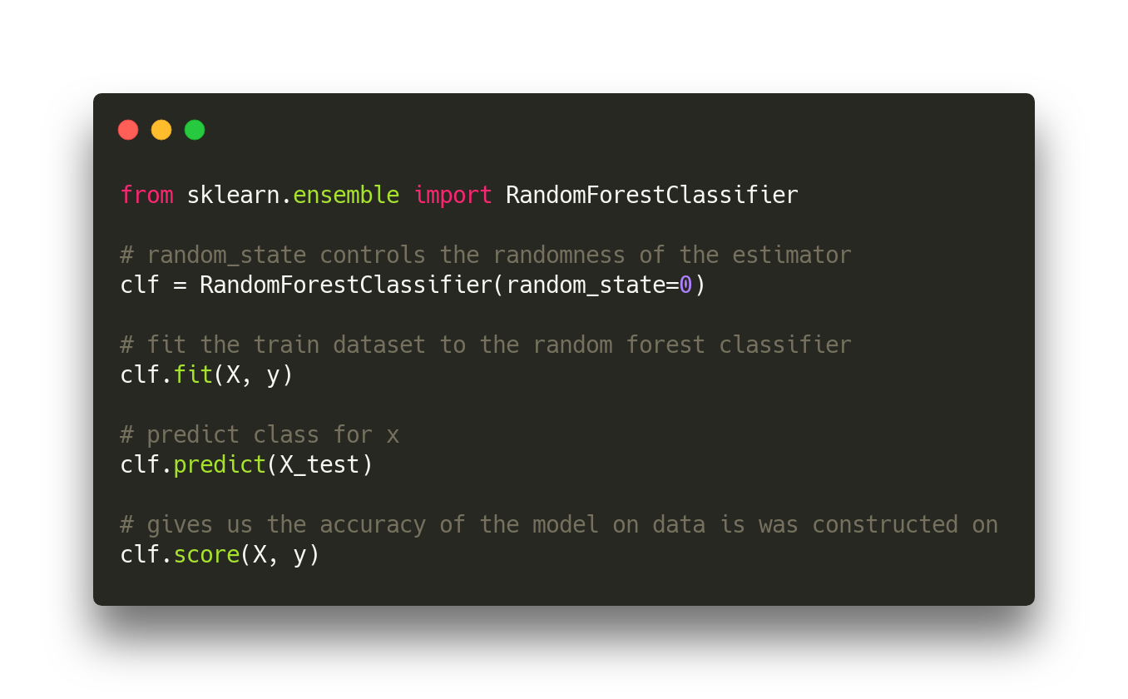
Random forest

Slide 5
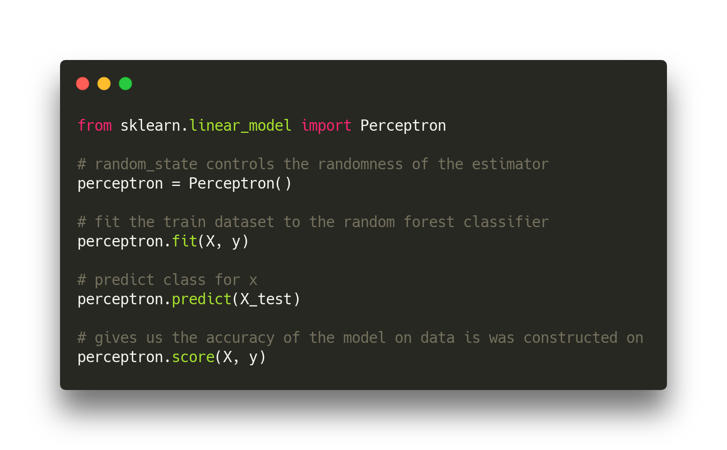
Perceptron

Slide 6
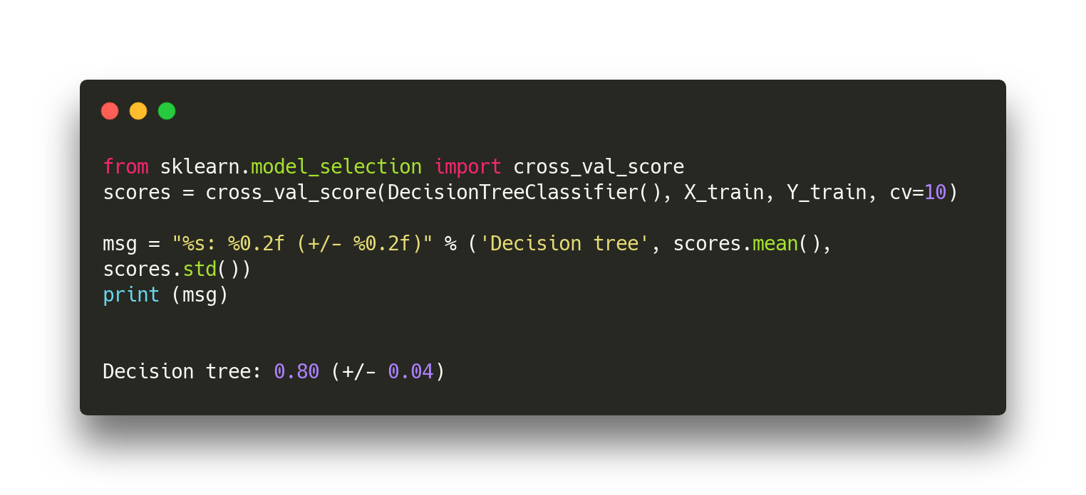
Decision tree w/ cross-validation

